Slide 1
Artificial Neural Networks
Dr Anil K Ahlawat

Slide 2
Artificial Neural Network

Slide 3
Artificial Neural Network
Biological Neuron

Slide 4
Biological inspirations
Some numbers…
The human brain contains about 10 billion nerve cells (neurons)
Each neuron is connected to the others through 10000 synapses
Properties of the brain
It can learn, reorganize itself from experience
It adapts to the environment
It is robust and fault tolerant

Slide 5

How do our brains work?
The Brain is A massively parallel information processing system.
Our brains are a huge network of processing elements. A typical brain contains a network of 10 billion neurons.

Slide 6
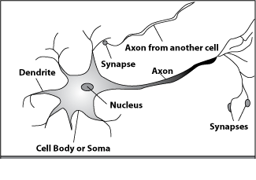
How do our brains work?
A processing element
Dendrites: Input
Cell body: Processor
Synaptic: Link
Axon: Output

Slide 7
Biological neuron
A neuron has
A branching input (dendrites)
A branching output (the axon)
The information circulates from the dendrites to the axon via the cell body
Axon connects to dendrites via synapses
Synapses vary in strength
Synapses may be excitatory or inhibitory
Notes:
Excitatory neurons are neurons that release neurotransmitters to make the post-synaptic neuron generate an action potential while inhibitory neurons are neurons that release neurotransmitters to make the post-synaptic neuron less-likely to generate an action potential.

Slide 8
How do our brains work?
A neuron is connected to other neurons through about 10,000 synapses
A neuron receives input from other neurons. Inputs are combined.
Once input exceeds a critical level, the neuron discharges a spike ‐ an electrical pulse that travels from the body, down the axon, to the next neuron(s)

Slide 9
How do our brains work?
The axon endings almost touch the dendrites or cell body of the next neuron.
Transmission of an electrical signal from one neuron to the next is effected by neurotransmitters
Neurotransmitters are chemicals which are released from the first neuron and which bind to the Second.

Slide 10
How do our brains work?
This link is called a synapse. The strength of the signal that reaches the next neuron depends on factors such as the amount of neurotransmitter available.

Slide 11
Connectionist Models
Consider humans:
Neuron switching time ~ .001 second
Number of neurons ~ 10¹⁰
Connections per neuron ~ 10⁴⁻⁵
Scene recognition time ~ .1 second
100 inference steps doesn’t seem like enough
→ much parallel computation

Slide 12
When to Consider Neural Networks
Input is high-dimensional discrete or real-valued
(e.g. raw sensor input)
Output is discrete or real valued
Output is a vector of values
Possibly noisy data
Form of target function is unknown
Human readability of result is unimportant
Examples:
Speech phoneme recognition [Waibel]
Image classification [Kanade, Baluja, Rowley]
Financial prediction

Slide 13
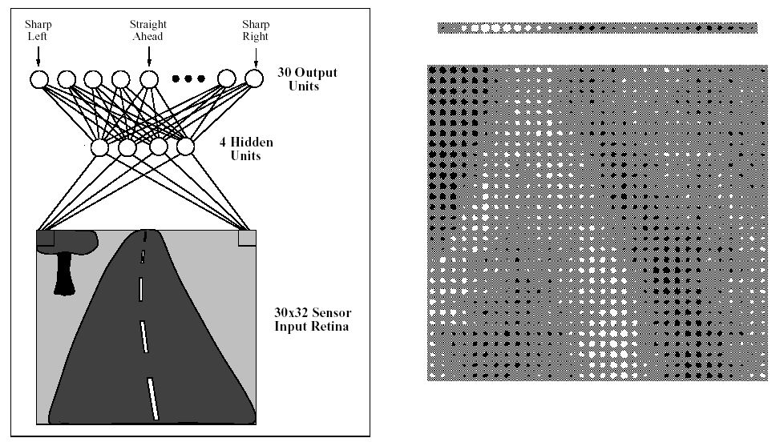
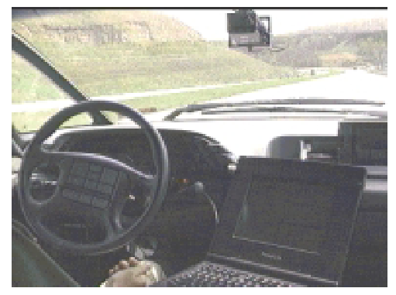
ALVINN drives 70 mph on highways

Slide 14
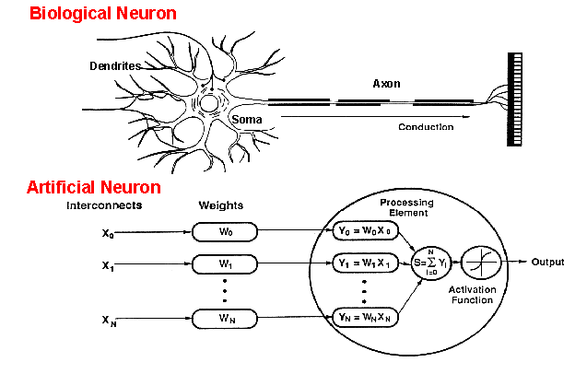
How do ANNs work?
An artificial neuron is an imitation of a human neuron

Slide 15
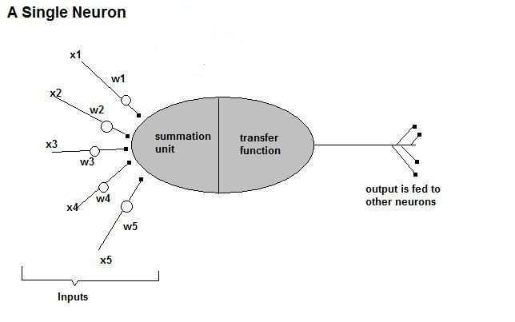
How do ANNs work?
• Now, let us have a look at the model of an artificial neuron.

Slide 16
What is an artificial neuron ?
Definition : Non linear, parameterized function with restricted output range
y
w0
x1
x2
x3

Slide 17
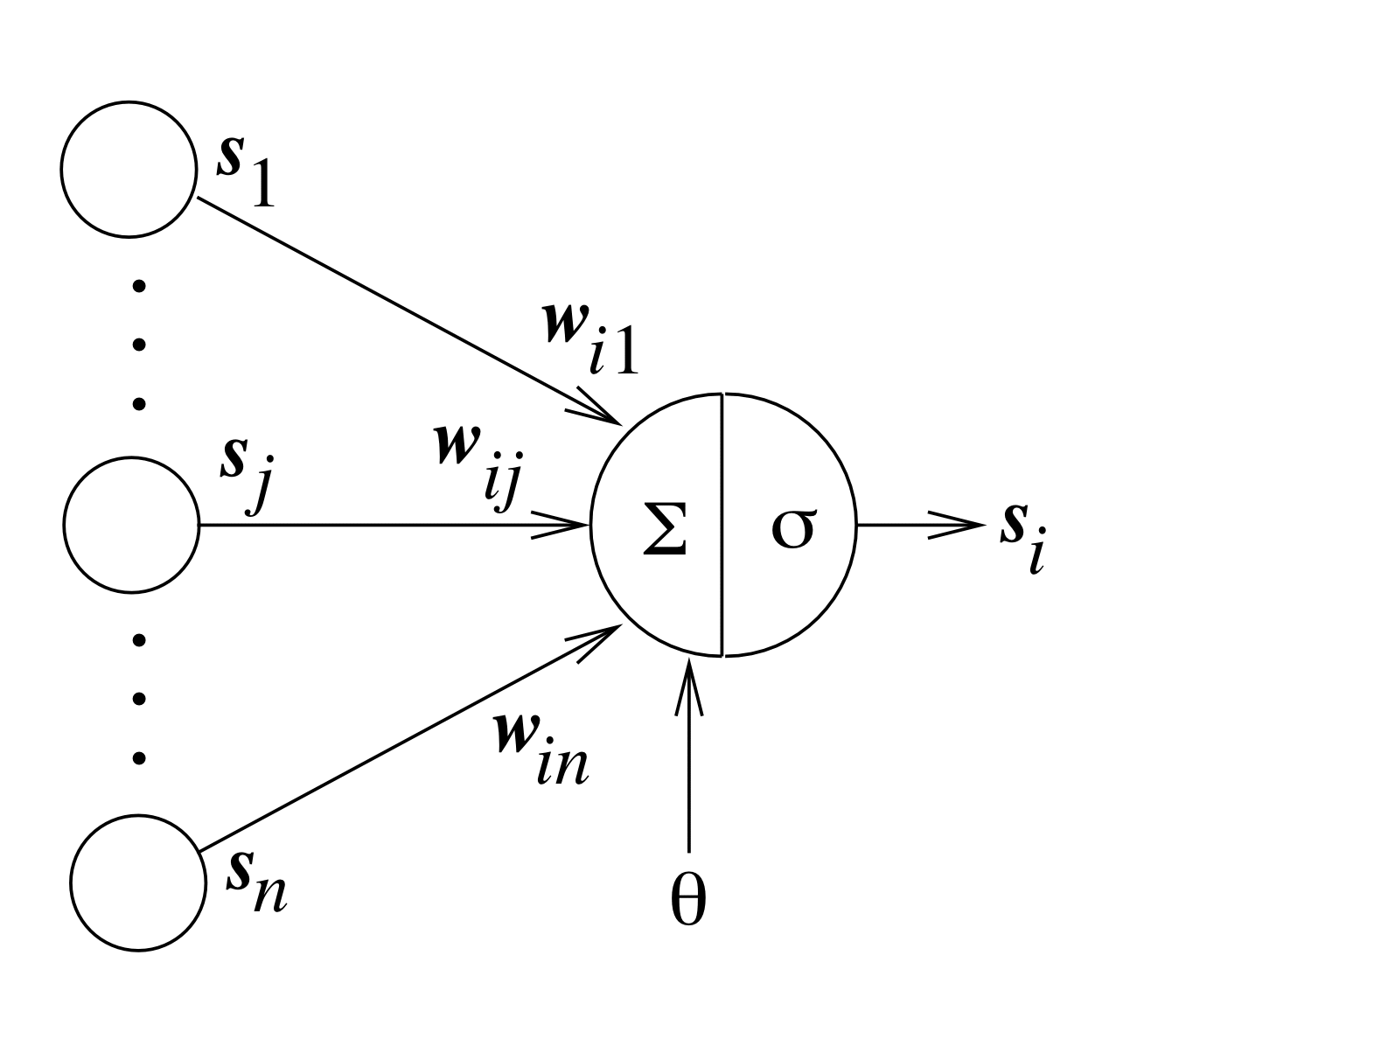
Typical Artificial Neuron
connection weights
inputs
output
threshold

Slide 18
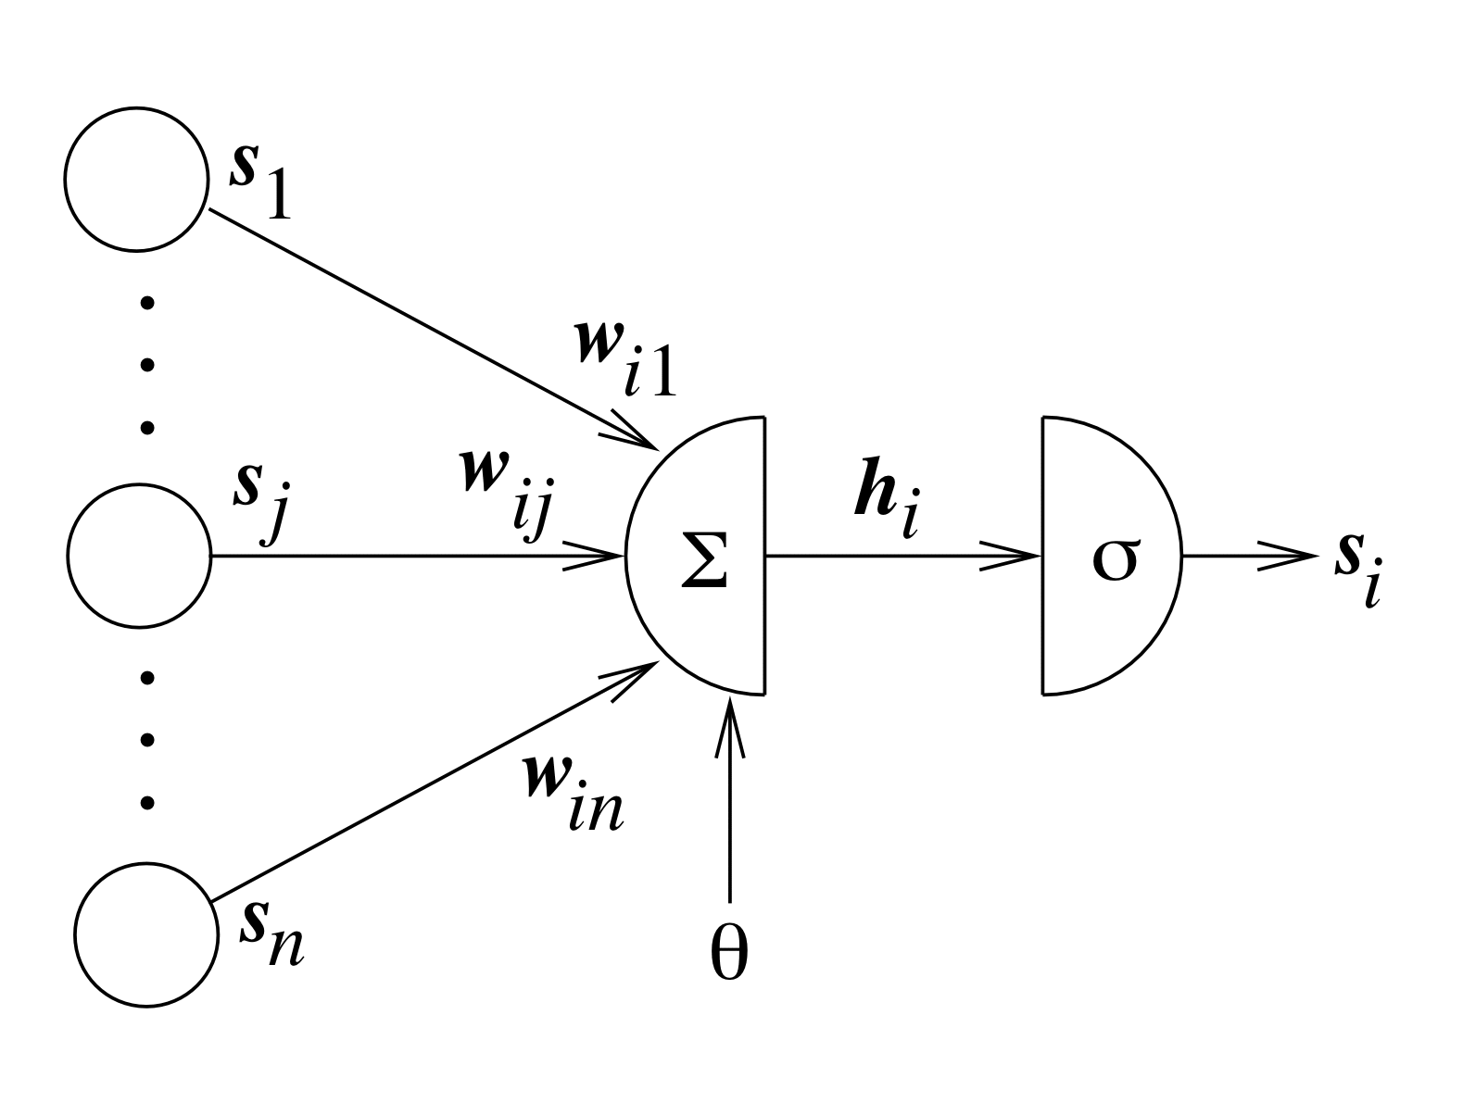
Typical Artificial Neuron
linear combination
activation function
net input (local field)

Slide 19
Equations
Net input:
Neuron output:

Slide 20
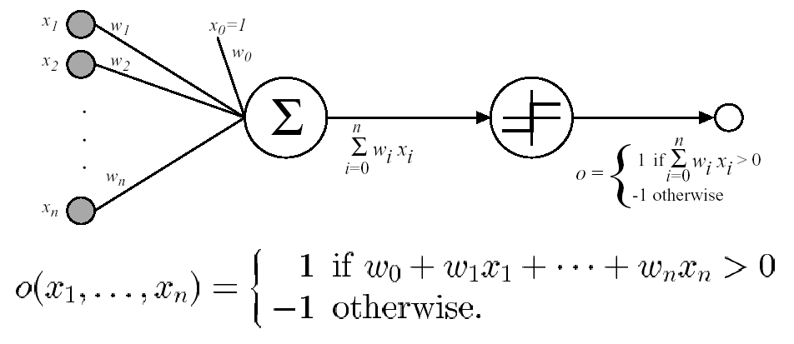
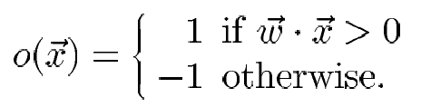
Perceptron
Sometimes we’ll use simpler vector notation:

Slide 21
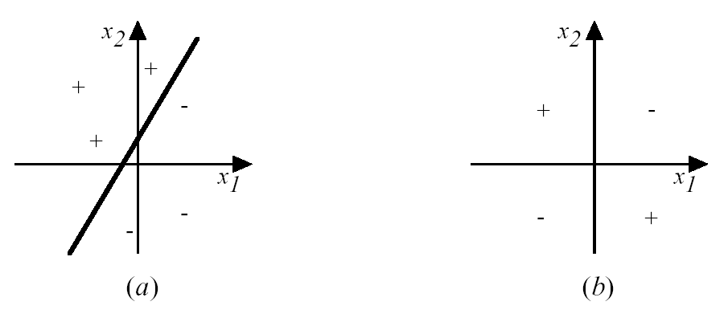
Decision Surface of a Perceptron
Represents some useful functions
What weights represent
g(x₁, x₂) = AND(x₁, x₂)?
But some functions not representable
e.g., not linearly separable
Therefore, we’ll want networks of these...

Slide 22
Perceptron training rule
w_{i} ← w_{i} + Δw_{i}
where Δw_{i} = η (t – o) x_{i}
Where:
t = c(x) is target value
o is perceptron output
η is small constant (e.g., .1) called learning rate
Can prove it will converge
If training data is linearly separable
and η sufficiently small

Slide 23
How do ANNs work?
Input
xm
. . . . . . . . . . . .
x2
x1
Processing
∑
∑= X₁+X₂ + ….+X_{m} =y
Output
y

Slide 24

How do ANNs work?
Not all inputs are equal
xm
. . . . . . . . . . . .
x2
x1
Input
w_{m}
w₂
w₁
weights
. . . . .
Processing
∑
∑= X₁w₁+X₂w₂ + ….+X_{m}w_{m} =y
Output
y

Slide 25

How do ANNs work?
The signal is not passed down to the
next neuron verbatim
xm
. . . . . . . . . . . .
x2
x1
Input
w_{m}
w₂
w₁
weights
. . . . .
Processing
∑
Transfer Function (Activation Function)
f(v_{k})
Output
y

Slide 26
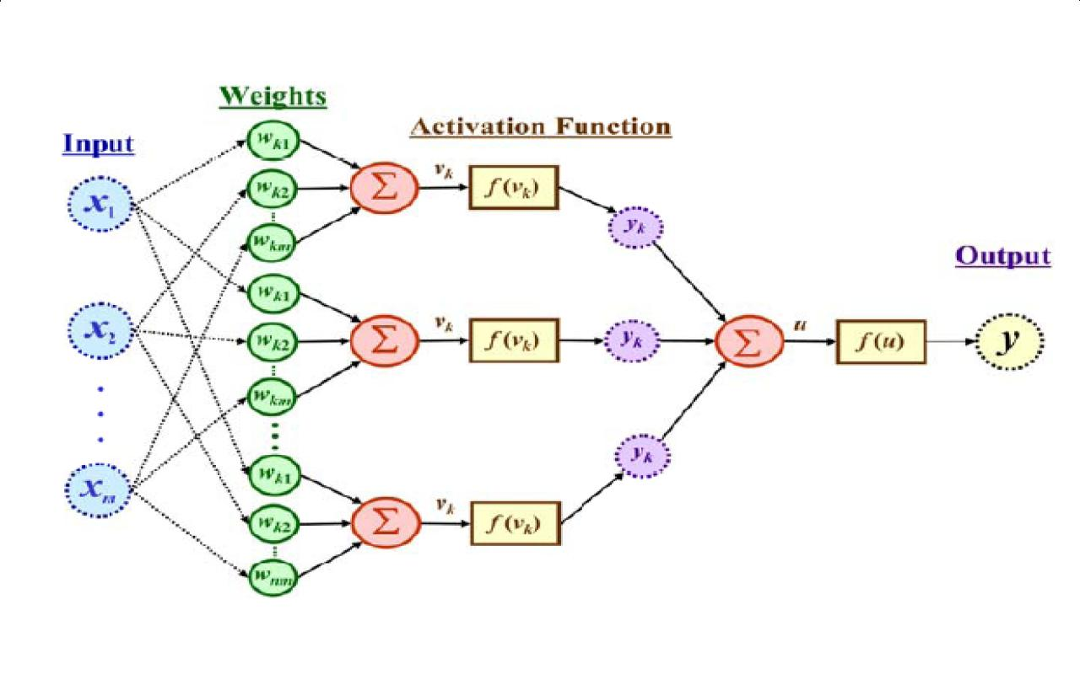
The output is a function of the input, that is affected by the weights, and the transfer functions

Slide 27
Activation functions
Sign function
Linear function
Step function
Sigmoid
(logistic) function
step(x) = 1, if x >= threshold
0, if x < threshold
(in picture above, threshold = 0)
sign(x) = +1, if x >= 0
-1, if x < 0
sigmoid(x) = 1/(1+e^{-x})
pl(x) =x
Adding an extra input with activation a₀ = -1 and weight
W_{0,j} = t (called the bias weight) is equivalent to having a
threshold at t. This way we can always assume a 0 threshold.

Slide 28
Real vs. Artificial Neurons
dendrites
cell
axon
synapse
dendrites
x₀
w₀
Threshold units
o
x_{n}
w_{n}

Slide 29
Neurons as Universal computing machine
In 1943, McCulloch and Pitts showed that a synchronous assembly of such neurons is a universal computing machine.
That is, any Boolean function can be implemented with threshold (step function) units.

Slide 30
Implementing AND
-1
x₁
1
W=1.5
o(x₁,x₂)
x₂
1

Slide 31
Implementing OR
-1
x₁
1
W=0.5
o(x₁,x₂)
x₂
1
o(x1,x2) = 1 if –0.5 + x1 + x2 > 0
= 0 otherwise

Slide 32
NNs vs Computers
Digital Computers
Deductive Reasoning. We apply known rules to input data to produce output.
Computation is centralized, synchronous, and serial.
Memory is packetted, literally stored, and location addressable.
Not fault tolerant. One transistor goes and it no longer works.
Exact.
Static connectivity.
Applicable if well defined rules with precise input data.
Neural Networks
Inductive Reasoning. Given input and output data (training examples), we construct the rules.
Computation is collective, asynchronous, and parallel.
Memory is distributed, internalized, short term and content addressable.
Fault tolerant, redundancy, and sharing of responsibilities.
Inexact.
Dynamic connectivity.
Applicable if rules are unknown or complicated, or if data are noisy or partial.

Slide 33
Artificial Neural Networks (ANN)
What is an Artificial Neural Network?
Artificial Neural Networks are crude attempts to model the highly massive parallel and distributed processing we believe takes place in the brain.

Slide 34
Introduction
In practice, NNs are especially useful for mapping problems which are tolerant of some errors and have lots of example data available, but to which hard and fast rules can not easily be applied.
In a nutshell a Neural network can be considered as a black box that is able to predict an output pattern when it recognizes a given input pattern.
Once trained, the neural network is able to recognize similarities when presented with a new input pattern, resulting in a predicted output pattern.

Slide 35
Neural Networks
A mathematical model to solve engineering problems
Group of highly connected neurons to realize compositions of non linear functions
Tasks
Classification
Discrimination
Estimation
2 types of networks
Feed forward Neural Networks
Recurrent Neural Networks

Slide 36
Why Artificial Neural Networks?
There are two basic reasons why we are interested in building artificial neural networks (ANNs):
Technical viewpoint: Some problems such as character recognition or the prediction of future states of a system require massively parallel and adaptive processing.
Biological viewpoint: ANNs can be used to replicate and simulate components of the human (or animal) brain, thereby giving us insight into natural information processing.

Slide 37
ANN Architecture
Feedforward: Links are unidirectional, and there are no cycles, i.e., the network is a directed acyclic graph (DAG).
Units are arranged in layers, and each unit is linked only to units in the next layer.
There is no internal state other than the weights.
Recurrent: Links can form arbitrary topologies, which can implement memory.
Behavior can become unstable, oscillatory.

Slide 38
Artificial Neural Network Feedforward Network
Output layer
fully connected
Hidden layers
Input layer
sparsely connected

Slide 39
Artificial Neural Network Recurrent Architecture
Feedback connections

Slide 40
Transfer Functions
Linear: The output is proportional to the total weighted input.
Threshold: The output is set at one of two values, depending on whether the total weighted input is greater than or less than some threshold value.
Non‐linear: The output varies continuously but not linearly as the input changes.

Slide 41
Error Estimation
The root mean square error (RMSE) is a frequently-used measure of the differences between values predicted by a model or an estimator and the values actually observed from the thing being modeled or estimated

Slide 42
Weights Adjusting
After each iteration, weights should be adjusted to minimize the error.
– All possible weights
– Back propagation

Slide 43
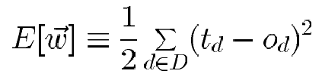
Gradient Descent (1/4)
To understand, consider simpler linear unit, where
o = w₀ + w₁x₁ + ··· + w_{n}x_{n}
Let's learn w_{i}’s that minimize the squared error
Where D is set of training examples

Slide 44
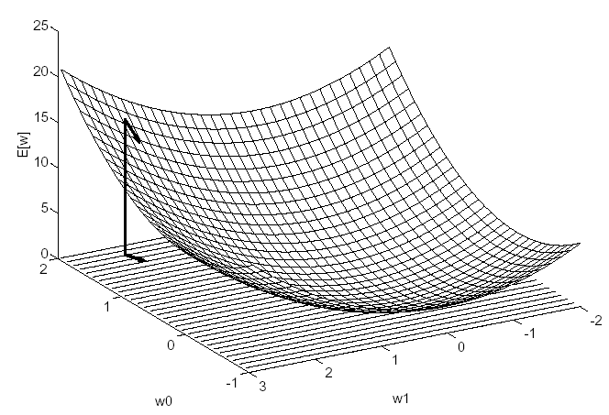
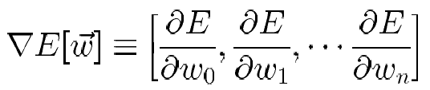
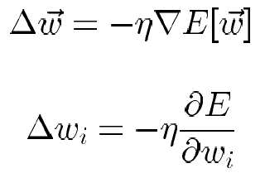
Gradient Descent (2/4)
Gradient
Training rule:
i.e.,

Slide 45
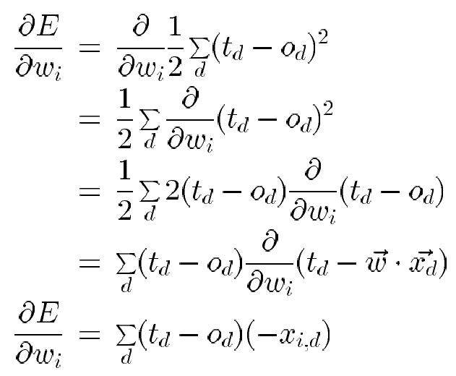
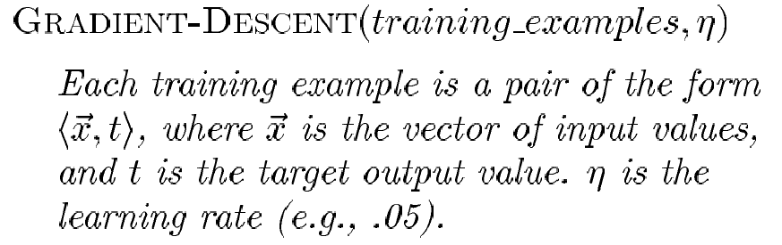
Gradient Descent (3/4)

Slide 46
Gradient Descent (4/4)
Initialize each w_{i} to some small random value
Until the termination condition is met, Do
Initialize each Δw_{i} to zero.
For each <x, t> in training_examples, Do
* Input the instance x to the unit and compute the output o
* For each linear unit weight w_{i}, Do
Δw_{i} ← Δw_{i} + η (t – o) x_{i}
For each linear unit weight w_{i} , Do
w_{i} ← w_{i} + Δw_{i}

Slide 47
Summary
Perceptron training rule guaranteed to succeed if
Training examples are linearly separable
Sufficiently small learning rate η
Linear unit training rule uses gradient descent
Guaranteed to converge to hypothesis with minimum squared error
Given sufficiently small learning rate η
Even when training data contains noise
Even when training data not separable by H

Slide 48
Incremental (Stochastic) Gradient Descent (1/2)
Batch mode Gradient Descent:
Do until satisfied
1. Compute the gradient E_{D}[w]
2. w ← w - η E_{D}[w]
Incremental mode Gradient Descent:
Do until satisfied
For each training example d in D
1. Compute the gradient E_{d}[w]
2. w ← w - η E_{d}[w]

Slide 49
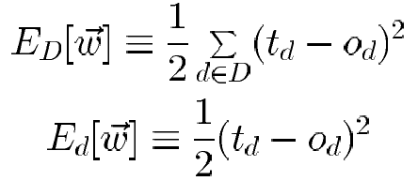
Incremental (Stochastic) Gradient Descent (2/2)
Incremental Gradient Descent can approximate Batch Gradient Descent arbitrarily closely if η made small enough

Slide 50
Back Propagation
Back-propagation is an example of supervised learning is used at each layer to minimize the error between the layer’s response and the actual data
The error at each hidden layer is an average of the evaluated error
Hidden layer networks are trained this way

Slide 51
Simple Back Propagation
N is a neuron.
N_{w} is one of N’s inputs weights
N_{out} is N’s output.
N_{w} = N_{w} +Δ N_{w}
Δ N_{w} = N_{out} * (1‐ N_{out})* N_{ErrorFactor}
N_{ErrorFactor} = N_{ExpectedOutput} – N_{ActualOutput}
This works only for the last layer, as we can know the actual output, and the expected output.

Slide 52
Backpropagation Algorithm
Initialize all weights to small random numbers. Until satisfied, Do
For each training example, Do
1. Input the training example to the network and compute the
network outputs
2. For each output unit k : δ_{k} ← ο_{k}(1 - ο_{k}) (t_{k} - ο_{k})
3. For each hidden unit h
δ_{h} ← ο_{h}(1 - ο_{h}) _{k ∈outputs} w_{h,k}δ_{k}
4. Update each network weight w_{i,j}
w_{i,j} ← w_{i,j} + Δw_{i,j}
where Δw_{i,j} = η δ_{j} x_{i,j}
Σ

Slide 53
More on Backpropagation
Easily generalized to arbitrary directed graphs
Will find a local, not necessarily global error minimum
In practice, often works well (can run multiple times)
Often include weight momentum α
Δw_{i,j} (n) = η δ_{j} x_{i,j} + α Δw_{i,j} (n - 1)
Minimizes error over training examples
Will it generalize well to subsequent examples?
Training can take thousands of iterations → slow!
Using network after training is very fast

Slide 54
Number of neurons
Many neurons:
Higher accuracy
Slower
Risk of over‐fitting
Memorizing, rather than understanding
The network will be useless with new problems.
Few neurons:
Lower accuracy
Inability to learn at all
Optimal number.

Slide 55
Data representation
Usually input/output data needs pre‐processing
Pictures
Pixel intensity
Text:
A pattern

Slide 56
Size of training set
No one‐fits‐all formula
Over fitting can occur if a “good” training set is not chosen
What constitutes a “good” training set?
Samples must represent the general population.
Samples must contain members of each class.
Samples in each class must contain a wide range of variations or noise effect.
The size of the training set is related to the number of hidden neurons

Slide 57
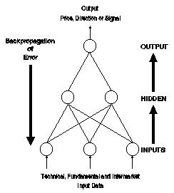
An overview of the backpropagation
The input data is entered into the network via the input layer.
Each neuron in the network processes the input data with the resultant values steadily "percolating" through the network, layer by layer, until a result is generated by the output layer.

Slide 58
An overview of the backpropagation
The actual output of the network is compared to expected output for that particular input.
This results in an error value.
The connection weights in the network are gradually adjusted, working backwards from the output layer, through the hidden layer, and to the input layer, until the correct output is produced.
Fine tuning the weights in this way has the effect of teaching the network how to produce the correct output for a particular input, i.e. the network learns.

Slide 59
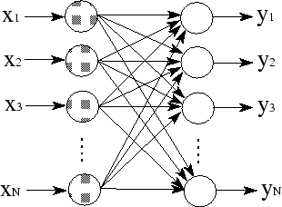
Single-Layer Network
The most common structure of connecting neurons into a network is by layers.
The simplest form of layered network is shown in figure.
The shaded nodes on the left are in the so-called input layer.
The input layer neurons are to only pass and distribute the inputs and perform no computation.
Thus, the only true layer of neurons is the one on the right.
Each of the inputs x1,x2,…xN is connected to every artificial neuron in the output layer through the connection weight.

Slide 60
Single-Layer Network
Since every value of outputs y1,y2,…yN is calculated from the same set of input values, each output is varied based on the connection weights.
Although the presented network is fully connected, the true biological neural network may not have all possible connections - the weight value of zero can be represented as ``no connection".

Slide 61
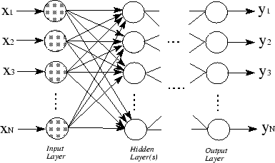
Multilayer Network
To achieve higher level of computational capabilities, a more complex structure of neural network is required.
Figure shows the multilayer neural network which distinguishes itself from the single-layer network by having one or more hidden layers.
In this multilayer structure, the input nodes pass the information to the units in the first hidden layer, then the outputs from the first hidden layer are passed to the next layer, and so on.

Slide 62
Multilayer Network
Multilayer network can also be viewed as cascading of groups of single-layer networks.
The level of complexity in computing can be seen by the fact that many single-layer networks are combined into this multilayer network.
The designer of an artificial neural network should consider how many hidden layers are required, depending on complexity in desired computation.

Slide 63
BP problem
Convergence
Local Minima

Slide 64
Question
You are given a data set consisting of variables having more than 30% missing values? Let’s say, out of 50 variables, 8 variables have missing values higher than 30%. How will you deal with them?

Slide 65
Design Issues
Initial weights (small random values ∈[‐1,1])
Transfer function (How the inputs and the weights are combined to produce output?)
Error estimation
Weights adjusting
Number of neurons
Data representation
Size of training set

Slide 66
Design Conciderations
What transfer function should be used?
How many inputs does the network need?
How many hidden layers does the network need?
How many hidden neurons per hidden layer?
How many outputs should the network have?
There is no standard methodology to determinate these values. Even there is some heuristic points, final values are determinate by a trial and error procedure.

Slide 67
Preprocessing

Slide 68
Why Preprocessing ?
The curse of Dimensionality
The quantity of training data grows exponentially with the dimension of the input space
In practice, we only have limited quantity of input data
Increasing the dimensionality of the problem leads to give a poor representation of the mapping

Slide 69
Preprocessing methods
Normalization
Translate input values so that they can be exploitable by the neural network
Component reduction
Build new input variables in order to reduce their number
No Lost of information about their distribution

Slide 70
Character recognition example
Image 256x256 pixels
8 bits pixels values (grey level)
Necessary to extract features

Slide 71
Normalization
Inputs of the neural net are often of different types with different orders of magnitude (E.g. Pressure, Temperature, etc.)
It is necessary to normalize the data so that they have the same impact on the model
Center and reduce the variables

Slide 72
Average on all points
Variance calculation
Variables transposition

Slide 73
Components reduction
Sometimes, the number of inputs is too large to be exploited
The reduction of the input number simplifies the construction of the model
Goal : Better representation of the data in order to get a more synthetic view without losing relevant information
Reduction methods (PCA, CCA, etc.)

Slide 74
« Intelligent preprocessing »
Use an “a priori” knowledge of the problem to help the neural network in performing its task
Reduce manually the dimension of the problem by extracting the relevant features
More or less complex algorithms to process the input data

Slide 75
When to use ANNs?
Input is high-dimensional discrete or real-valued (e.g. raw sensor input).
Inputs can be highly correlated or independent.
Output is discrete or real valued
Output is a vector of values
Possibly noisy data. Data may contain errors
Form of target function is unknown
Long training time are acceptable
Fast evaluation of target function is required
Human readability of learned target function is unimportant
⇒ ANN is much like a black-box

Slide 76
What do we need to use NN ?
Determination of pertinent inputs
Collection of data for the learning and testing phase of the neural network
Finding the optimum number of hidden nodes
Estimate the parameters (Learning)
Evaluate the performances of the network
IF performances are not satisfactory then review all the precedent points

Slide 77
Matlab Demo
Learning XOR function
Function approximation
Digit Recognition

Slide 78
Learning XOR Operation: Matlab Code
P = [ 0 0 1 1; ...
0 1 0 1]
T = [ 0 1 1 0];
net = newff([0 1;0 1],[6 1],{'tansig' 'tansig'});
net.trainParam.epochs = 5000;
net = train(net,P,T);
X = [0 1];
Y = sim(net,X);
display(Y);

Slide 79
Function Approximation: Learning Sinus Function
P = 0:0.1:10;
T = sin(P)*10.0;
net = newff([0.0 10.0],[8 1],{'tansig' 'purelin'});
plot(P,T); pause;
Y = sim(net,P); plot(P,T,P,Y,’o’); pause;
net.trainParam.epochs = 5000;
net = train(net,P,T);
Y = sim(net,P); plot(P,T,P,Y,’o’);

Slide 80
Digit Recognition:
P = [ 1 0 1 1 1 1 1 1 1 1 ;
1 1 1 1 0 1 1 1 1 1 ;
1 0 1 1 1 1 1 1 1 1 ;
1 0 0 0 1 1 1 0 1 1 ;
0 1 0 0 0 0 0 0 0 0 ;
1 0 1 1 1 0 0 1 1 1 ;
1 0 1 1 1 1 1 0 1 1 ;
0 1 1 1 1 1 1 0 1 1 ;
1 0 1 1 1 1 1 1 1 1 ;
1 0 1 0 0 0 1 0 1 0 ;
0 1 0 0 0 0 0 0 0 0 ;
1 0 0 1 1 1 1 1 1 1 ;
1 0 1 1 0 1 1 0 1 1 ;
1 1 1 1 0 1 1 0 1 1 ;
1 0 1 1 1 1 1 1 1 1 ];
T = [ 1 0 0 0 0 0 0 0 0 0 ;
0 1 0 0 0 0 0 0 0 0 ;
0 0 1 0 0 0 0 0 0 0 ;
0 0 0 1 0 0 0 0 0 0 ;
0 0 0 0 1 0 0 0 0 0 ;
0 0 0 0 0 1 0 0 0 0 ;
0 0 0 0 0 0 1 0 0 0 ;
0 0 0 0 0 0 0 1 0 0 ;
0 0 0 0 0 0 0 0 1 0 ;
0 0 0 0 0 0 0 0 0 1 ];

Slide 81
Digit Recognition:
net = newff([0 1;0 1;0 1;0 1;0 1;0 1;0 1; 0 1;0 1;0 1;0 1;0 1;0 1;0 1;0 1], [20 10],{'tansig' 'tansig'});
net.trainParam.epochs = 4850;
net = train(net,P,T);

Slide 82
Application Development

Slide 83
Neural Networks Projects Are Different
Projects are data driven: Therefore, there is a need to collect and analyse data as part of the design process and to train the neural network. This task is often time-consuming and the effort, resources and time required are frequently underestimated
It is not usually possible to specify fully the solution at the design stage: Therefore, it is necessary to build prototypes and experiment with them in order to resolve design issues. This iterative development process can be difficult to control
Performance, rather than speed of processing, is the key issue: More attention must be paid to performance issues during the requirements analysis, design and test phases. Furthermore, demonstrating that the performance meets the requirements can be particularly difficult.
These issues affect the following areas :
Project planning
Project management
Project documentation

Slide 84
Project life cycle
Application Identification
Feasibility Study
Design Prototype
Data Collection
Development and validation of prototype
Build Train and Test
Optimize prototype
Validate prototype
Implement System
Validate System

Slide 85
NNs in real problems
Rest of System
Raw data
Pre-processing
Feature vector
Input encode
Network inputs
Neural Network
Network outputs
Output encode
Decoded outputs
Post-processing
Rest of System

Slide 86
Pre-processing
Transform data to NN inputs
Applying a mathematical or statistical function
Encoding textual data from a database
Selection of the most relevant data and outlier removal
Minimizing network inputs
Feature extraction
Principal components analysis
Waveform / Image analysis
Coding pre-processing data to network inputs

Slide 87
1. Using Neural Networks to Forecast Stock Market Prices

Slide 88
Motivation behind using NN
Neural networks are used to predict stock market prices because they are able to learn nonlinear mappings between inputs and outputs.
It may be possible that NN outperforms the traditional analysis and other computer-based methods.

Slide 89
Traditional Methods
Traditional methods used were:
Statistics, technical analysis, fundamental analysis, and linear regression.
None of these techniques has proven to be the consistently correct prediction tool that is desired.

Slide 90
contd.
However, these methods are presented as they are commonly used in practice and represent a base-level standard, which neural networks should outperform.
Also, many of these techniques are used to preprocess raw data inputs, and their results are fed into neural networks as input.

Slide 91
Technical Analysis
Technical analysis rests on the assumption that history repeats itself and that future market direction can be determined by examining past prices.
Ex. Using price, volume, and open interest statistics, the technical analyst uses charts to predict future stock movements.

Slide 92
Fundamental Analysis
Fundamental analysis involves the in-depth analysis of a company’s performance and profitability to determine its share price.
By studying the overall economic conditions, the company’s competition, and other factors, it is possible to determine expected returns and the intrinsic value of shares.
This type of analysis assumes that a share’s current (and future) price depends on its intrinsic value and anticipated return on investment.

Slide 93
contd.
The advantages of fundamental analysis are its systematic approach and its ability to predict changes.
Unfortunately, it becomes harder to formalize all this knowledge for purposes of automation (with a neural network for example), and interpretation of this knowledge may be subjective.

Slide 94
Other techniques
Many other computer based techniques have been employed to forecast the stock market.
They range from charting programs to sophisticated expert systems. Fuzzy logic has also been used.

Slide 95
Comparison with Expert Systems
Expert systems process knowledge sequentially and formulate it into rules. In this capacity, expert systems can be used in conjunction with neural networks to predict the market.
In such a combined system, the neural network can perform its prediction, while the expert system could validate the prediction based on its well-known trading rules.

Slide 96
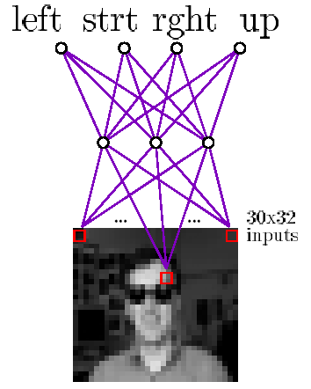
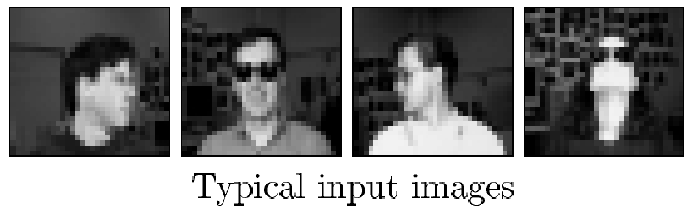
2. Neural Nets for Face Recognition
90% accurate learning head pose, and recognizing 1-of-20 faces

Slide 97
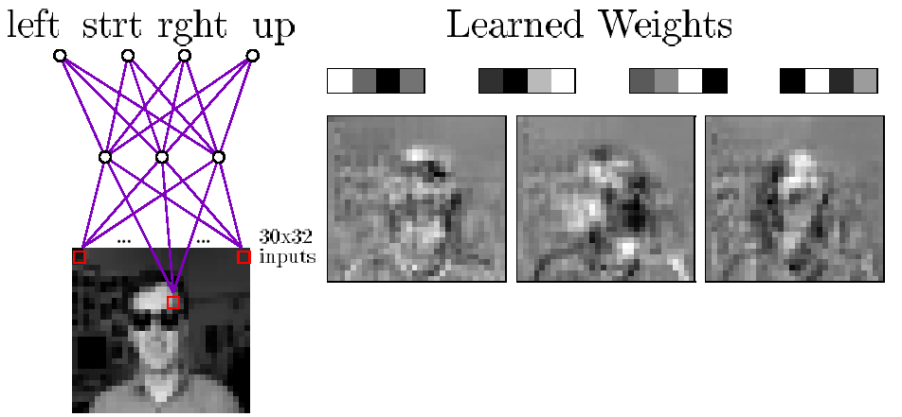
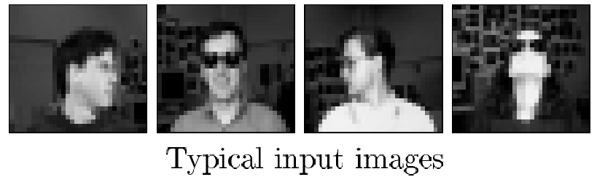
Learned Hidden Unit Weights
http://www.cs.cmu.edu/tom/faces.html

Slide 98
3. Application of NN to Stock Market Prediction
The networks are examined in three main areas:
Network environment
Training data
Network organization

Slide 99
Training a NN
A neural network must be trained on some input data.
The two major problems in implementing this training discussed in the following sections are:
Defining the set of input to be used (the learning environment)
Deciding on an algorithm to train the network

Slide 100
Learning Environment
One of the most important factors in constructing a neural network is deciding on what the network will learn.
The goal of most of these networks is to decide when to buy or sell securities based on previous market indicators.
The challenge is determining which indicators and input data will be used, and gathering enough training data to train the system appropriately.

Slide 101
Input Data
The input data may be raw data on volume, price, or daily change, but it may also include derived data such as technical indicators (moving average, trend-line indicators, etc.) or fundamental indicators (intrinsic share value, economic environment, etc.).
The input data should allow the neural network to generalize market behavior while containing limited redundant data.

Slide 102
Training Data
Training on large volumes of historical data is computationally and time intensive and may result in the network learning undesirable information in the data set.
For example, stock market data is time-dependent.
Sufficient data should be presented so that the neural network can capture most of the trends, but very old data may lead the network to learn patterns or factors that are no longer important or valuable.

Slide 103
Network Training
Training a network involves presenting input patterns in a way so that the system minimizes its error and improves its performance.
The training algorithm may vary depending on the network architecture, but the most common training algorithm used when designing financial neural networks is the back-propagation algorithm.

Slide 104
contd.
The most common network architecture for financial neural networks is a multilayer feedforward network trained using backpropagation.
Back-propagation is the process of back-propagating errors through the system from the output layer towards the input layer during training.
Back-propagation is necessary because hidden units have no training target value that can be used, so they must be trained based on errors from previous layers.
The output layer is the only layer which has a target value for which to compare.
As the errors are back-propagated through the nodes, the connection weights are changed.
Training occurs until the errors in the weights are sufficiently small to be accepted.

Slide 105
Over training
The major problem in training a neural network is deciding when to stop training.
Since the ability to generalize is fundamental for these networks to predict future stock prices, overtraining is a serious problem.
Overtraining occurs when the system memorizes patterns and thus looses the ability to generalize.
It is an important factor in these prediction systems as their primary use is to predict (or generalize) on input data that it has never seen.

Slide 106
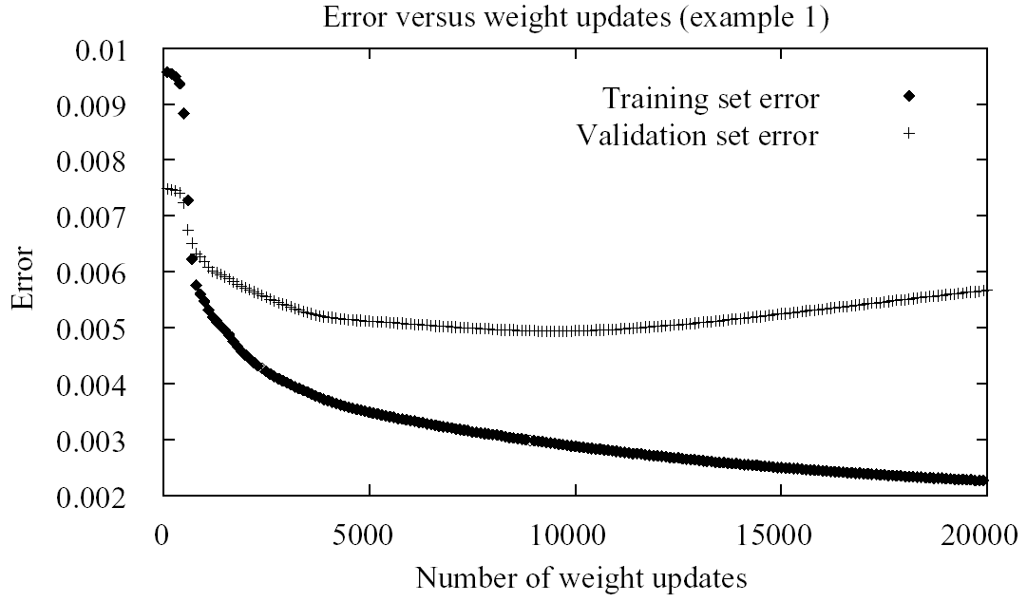
Overfitting in ANNs (1/2)

Slide 107
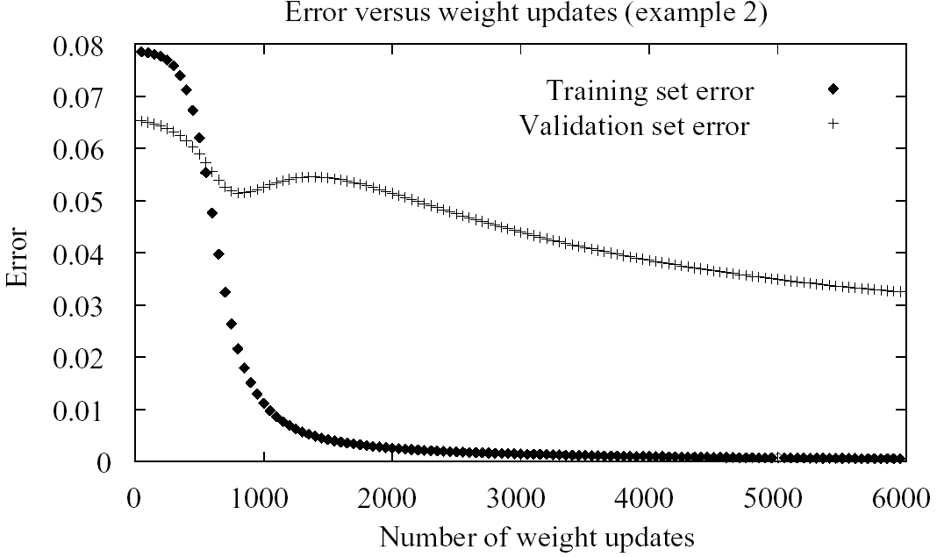
Overfitting in ANNs (2/2)

